Slide 1
Collections
Any group of individual objects which are represented as a single unit is known as the collection of the objects
In Java, a separate framework named the “Collection Framework” has been defined in JDK 1.2 which holds all the collection classes and interface in it. The Collection interface (java.util.Collection) and Map interface (java.util.Map) are the two main “root” interfaces of Java collection classes.
A framework is a set of classes and interfaces which provide a ready-made architecture.

Slide 2
Before the Collection Framework(or before JDK 1.2) was introduced, the standard methods for grouping Java objects (or collections) were Arrays or Vectors, or Hashtables.
All of these collections had no common interface. Therefore, though the main aim of all the collections is the same, the implementation of all these collections was defined independently and had no correlation among them.

Slide 3
Advantages of the Collection Framework
Consistent API: The API has a basic set of interfaces like Collection, Set, List, or Map, all the classes (ArrayList, LinkedList, Vector, etc) that implement these interfaces have some common set of methods.
Reduces programming effort:
Increases program speed and quality:Increases performance by providing high-performance implementations of useful data structures and algorithms

Slide 4
Hierarchy of the Collection Framework
The utility package, (java.util) contains all the classes and interfaces that are required by the collection framework.
The collection framework contains an interface named an iterable interface which provides the iterator to iterate through all the collections.
This interface is extended by the main collection interface which acts as a root for the collection framework.
All the collections extend this collection interface thereby extending the properties of the iterator and the methods of this interface.

Slide 5
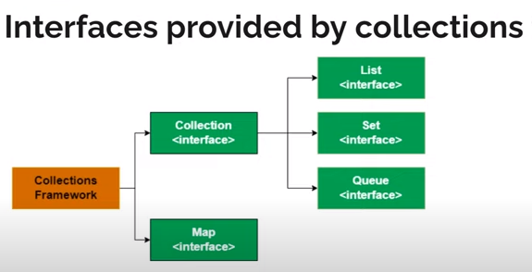

Slide 6
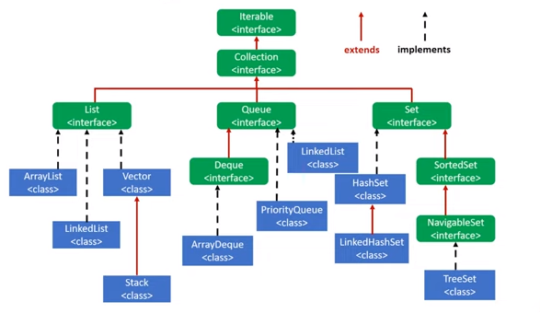
Hierarchy of Collection Interface

Slide 7
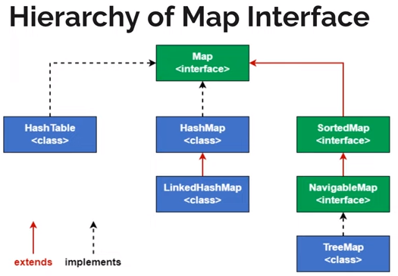

Slide 8
Interfaces that extend the Collections Interface
The collection framework contains multiple interfaces where every interface is used to store a specific type of data. The following are the interfaces present in the framework.
1. Iterable Interface:
This is the root interface for the entire collection framework. The collection interface extends the iterable interface. Therefore, inherently, all the interfaces and classes implement this interface.
The main functionality of this interface is to provide an iterator for the collections.
It contains only one abstract method. i.e.,
Iterator<T> iterator()

Slide 9
2. Collection Interface
This interface extends the iterable interface and is implemented by all the classes in the collection framework. This interface contains all the basic methods which every collection has like adding the data into the collection, removing the data, clearing the data, etc.
All these methods are implemented in this interface because these methods are implemented by all the classes irrespective of their style of implementation.
And also, having these methods in this interface ensures that the names of the methods are universal for all the collections.
This interface builds a foundation on which the collection classes are implemented.

Slide 10
List Interface
List interface is the child interface of Collection interface.
It inhibits a list type data structure in which we can store the ordered collection of objects.
It can have duplicate values.
List interface is implemented by the classes ArrayList, LinkedList, Vector, and Stack.
To instantiate the List interface, we must use :
List <data-type> l1= new ArrayList();
List <data-type> l2 = new LinkedList();
List <data-type> l3 = new Vector();
List <data-type> l4 = new Stack();
There are various methods in List interface that can be used to insert, delete, and access the elements from the list.

Slide 11
add(int index, element) | This method is used to add an element at a particular index in the list. When a single parameter is passed, it simply adds the element at the end of the list.
addAll(int index, Collection collection) | This method is used to add all the elements in the given collection to the list. When a single parameter is passed, it adds all the elements of the given collection at the end of the list.
size() | This method is used to return the size of the list.
clear() | This method is used to remove all the elements in the list. However, the reference of the list created is still stored.
remove(int index) | This method removes an element from the specified index. It shifts subsequent elements(if any) to left and decreases their indexes by 1.
remove(element) | This method is used to remove the first occurrence of the given element in the list.
get(int index) | This method returns elements at the specified index.

Slide 12
set(int index, element) | This method replaces elements at a given index with the new element. This function returns the element which was just replaced by a new element.
indexOf(element) | This method returns the first occurrence of the given element or -1 if the element is not present in the list.
lastIndexOf(element) | This method returns the last occurrence of the given element or -1 if the element is not present in the list.
equals(element) | This method is used to compare the equality of the given element with the elements of the list.
hashCode() | This method is used to return the hashcode value of the given list.
isEmpty() | This method is used to check if the list is empty or not. It returns true if the list is empty, else false.
contains(element) | This method is used to check if the list contains the given element or not. It returns true if the list contains the element.
containsAll(Collection collection) | This method is used to check if the list contains all the collection of elements.
sort(Comparator comp) | This method is used to sort the elements of the list on the basis of the given comparator.

Slide 13
ArrayList
The ArrayList class implements the List interface.
It uses a dynamic array to store the duplicate elements of different data types.
The ArrayList class maintains the insertion order and is non-synchronized.
The elements stored in the ArrayList class can be randomly accessed.
Creates a default Array of the initial capacity is 10.
when you insert an element into the ArrayList after 10 values , it increases its Array size by 50%

Slide 14
import java.util.*;
class GFG {
public static void main(String[] args) {
ArrayList<Integer> l1 = new ArrayList<Integer>();
l1.add(1);
l1.add(2);
System.out.println(l1);
ArrayList<Integer> l2 = new ArrayList<Integer>();
l2.add(1);
l2.add(2);
l2.add(2,3);
l1.addAll(1, l2);
System.out.println(l1);
l1.remove(2);
System.out.println(l1);
System.out.println(l1.get(3));
l1.set(0, 5);
System.out.println(l1);
ArrayList<String> l3 = new ArrayList<String>();
l3.add("Java");
l3.add("programming");
System.out.println(l3);
}
}

Slide 15
//iterating over list
import java.util.*;
public class GFG {
public static void main(String args[]) {
List<String> al = new ArrayList<>();
al.add(“Welcome");
al.add(“java");
al.add(1, “to");
System.out.println(al.size());
for (int i = 0; i < al.size(); i++) {
System.out.print(al.get(i) + " ");
}
System.out.println();
for (String str : al)
System.out.print(str + " ");
}
}

Slide 16
The iterator() method of ArrayList class in Java Collection Framework is used to get an iterator over the elements in this list in proper sequence.
import java.util.ArrayList;
import java.util.ListIterator;
class Main {
public static void main(String[] args) {
ArrayList<Integer> numbers = new ArrayList<>();
numbers.add(1);
numbers.add(3);
numbers.add(2);
System.out.println("ArrayList: " + numbers);
// Creating an instance of ListIterator
ListIterator<Integer> iterate = numbers.listIterator();
System.out.println("Iterating over ArrayList:");
while(iterate.hasNext()) {
System.out.print(iterate.next() + ", ");
} } }

Slide 17
//Iterating over the list using Listiterator
import java.util.*;
public class ListIteratorDemo {
public static void main(String[] args) {
List<String> names = new LinkedList<>();
names.add("Welcome");
names.add("To");
names.add("Gfg");
ListIterator<String> n = names.listIterator();
// Traversing elements using next() method
while (n.hasNext()) {
System.out.println(n.next());
}
System.out.println(names);
}
}

Slide 18
Vector
Vector is a class that is implemented in the collection framework implements a growable array of objects.
Vector implements a dynamic array that means it can grow or shrink as required.
Like an array, it contains components that can be accessed using an integer index.
Creates a default Vector of the initial capacity is 10.
when you insert an element into the ArrayList , it increases its Array size by 100%

Slide 19
import java.io.*;
import java.util.*;
class GFG {
public static void main(String[] args) {
int n = 5;
List<Integer> v = new Vector<Integer>(n);
for (int i = 1; i <= n; i++)
v.add(i);
System.out.println(v);
v.remove(3);
System.out.println(v);
for (int i = 0; i < v.size(); i++)
System.out.print(v.get(i) + " ");
}
}

Slide 20
Stack
Stack is a class that is implemented in the collection framework and extends the vector class models and implements the Stack data structure.
The class is based on the basic principle of last-in-first-out.
In addition to the basic push and pop operations, the class provides three more methods of empty, search and peek.

Slide 21
import java.io.*;
import java.util.*;
class Test {
public static void main(String[] args) {
int n = 5;
List<Integer> s = new Stack<Integer>(n);
for (int i = 1; i <= n; i++)
s.add(i);
System.out.println(s);
s.remove(3);
System.out.println(s);
for (int i = 0; i < s.size(); i++)
System.out.print(s.get(i) + " ");
}
}

Slide 22
import java.util.Stack;
public class StackEmptyMethodExample
{
public static void main(String[] args)
{
Stack<Integer> stk= new Stack<>();
stk.push(78);
stk.push(113);
stk.push(90);
stk.push(120);
System.out.println("Elements in Stack: " + stk);
stk.pop();
System.out.println("Elements in Stack: " + stk);
System.out.println("Element in Stack: " + stk.peek());
int location = stk.search(78);
System.out.println("Element in Stack: " +location);
boolean result = stk.empty();
System.out.println("Is the stack empty? " + result);
}
}

Slide 23
LinkedList
LinkedList implements the Collection interface.
It is a linear data structure where the elements are not stored in contiguous locations and every element is a separate object with a data part and address part.
The elements are linked using pointers and addresses.
Each element is known as a node. Due to the dynamicity and ease of insertions and deletions, Linkedlists are preferred over the arrays.
In LinkedList, the manipulation is fast because no shifting is required.

Slide 24
import java.util.List;
import java.util.LinkedList;
class Main {
public static void main(String[] args) {
List<Integer> numbers = new LinkedList<>();
numbers.add(1);
numbers.add(2);
numbers.add(3);
System.out.println("List: " + numbers);
// Access element from the list
int number = numbers.get(2);
System.out.println("Accessed Element: " + number);
// Using the indexOf() method
int index = numbers.indexOf(2);
System.out.println("Position of 3 is " + index);
// Remove element from the list
int removedNumber = numbers.remove(1);
System.out.println("Removed Element: " + removedNumber);
}
}

